Slide 1
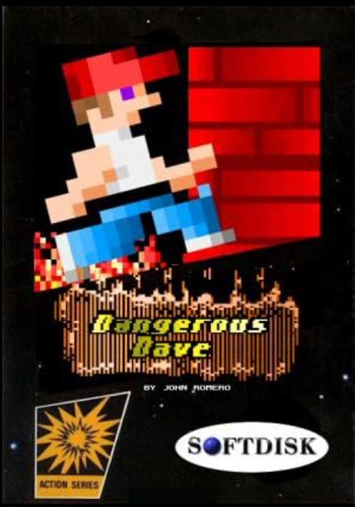
DE CONS TRUCtION OF
DECONSTRUCTION OF DANGEROUS DAVE
BY ATHUL K M MSC GT

Slide 2
INTRODUCTION
GAME OVERVIWE
GAMEPLAY AND OBJECTIVE
DANGEROUS DAVE
GAME SEQUELS
GAME REFERENCE
JOHN ROMERO
ID SOFTWARE
INTO THE GAMEOLAY OF DANGEROUS DAVE
INGAME VIEW
GAME LEVELS
COLLECTABLES
ENEMIES WORLD BUILDING Ui designing
Points to remember

Slide 3
GAME OVERVIEW
Dangerous Dave is the protagonist of the 1988 platformer game developed by John Romero. The game was initially released on Apple II and MS-DOS and has since been ported to other platforms.
Gameplay and Objective
In the game, Dave must navigate through 10 levels, collecting gold trophies to progress to the next stage. The objective is to explore the deserted pirate’s hideout, where Dave’s rival, Clyde Cooper, has hidden 10 skateboarding trophies. The game features similarities with Super Mario, including secret levels, level design, monsters, and jumping mechanics.
The player must collect all golden cups in each level to proceed to the next one. Each level increases in difficulty, introducing new obstacles and enemies.

Slide 4

DANGEROUS DAVE
Dave is a brave and daring adventurer with a love for treasure hunting and risky escape. Whether it's rescuing his brother Delbert(found in the Dave 2) or exploring dangerous locations for hidden gold, his love for treasure hunting often lands him in life-threatening situations. His quests are a mix of survival and exploration, and he faces everything from supernatural monsters.
Dave’s character design is reminiscent of Mario, with a similar jumping and platforming style.
The character is less detailed
The pixel block size were about 2

Slide 5
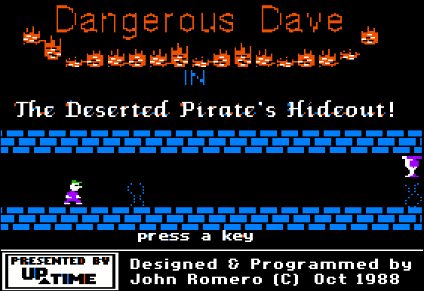
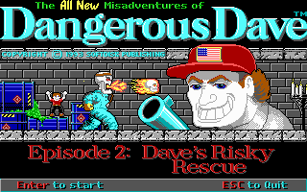

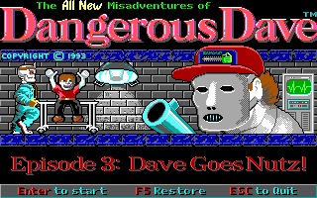
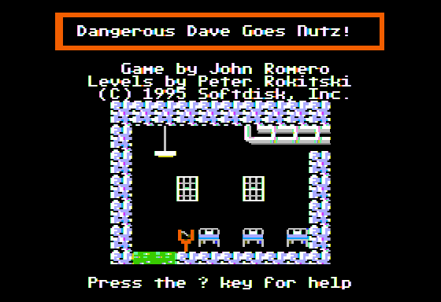
GAME SEQUELS

Slide 6
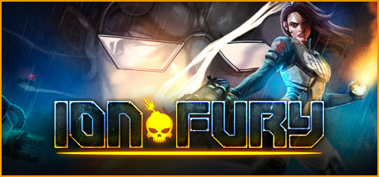
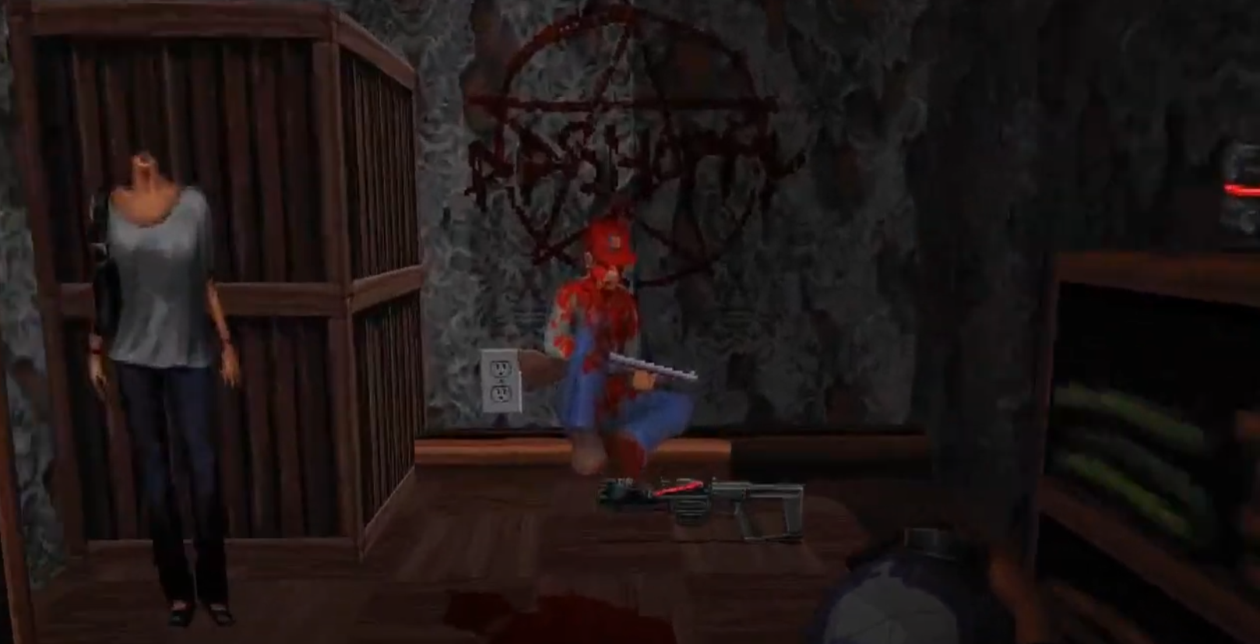
GAME REFERENCE
Ion Fury (originally titled as Ion Maiden) is a 2019 cyberpunk first-person shooter video game developed by Voidpoint and published by 3D Realms.
One of the developer was a fan of the game Dangerous Dave,so he made a reference from the game of Dangerous Dave into the Haunted Mansion.
The particular mission in the game of ION FURY takes place in the mansion similar to location used in the Dave’s game.
Ion Fury, has a secret room where the players can find Dave dead.
Which was one of the most popular easter egg of those times.

Slide 7

John Romero
CREATOR OF DANGEROUS DAVE
Alfonso John Romero (born October 28, 1967)^{[1]} is an American video game developer.
He is also known as the Godfather of the First Person Shooter games.
He designed their early games,including Wolfenstein 3D (1992), Doom (1993), Doom II (1994), Hexen (1995) and Quake (1996). His designs and development tools, along with programming techniques developed by the id programmer John Carmack, popularized the first-person shooter (FPS) genre. Romero is also credited with coining the multiplayer term "deathmatch".

Slide 8
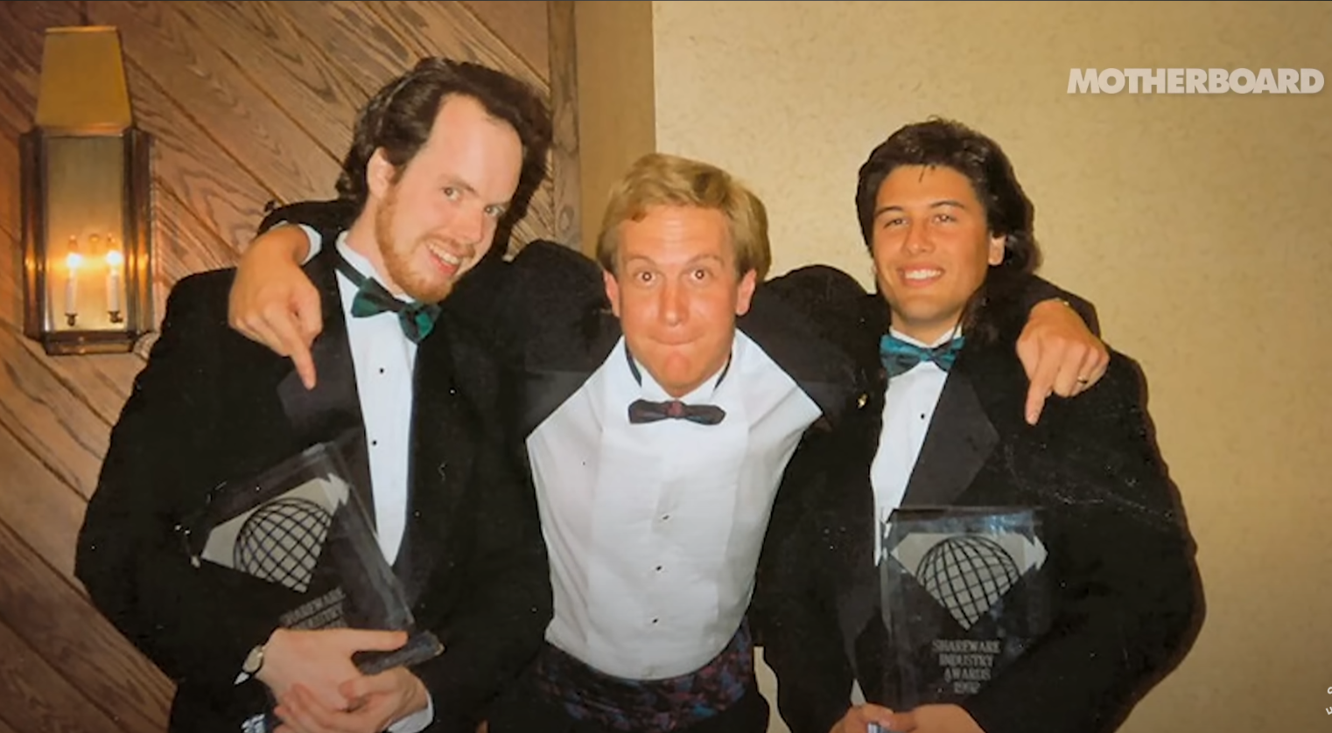

ID SOFTWARE
id Software is an American video game studio based in Richardson, Texas. It was founded on February 1, 1991, by four members of the computer company Softdisk: programmers John Carmack and John Romero, game designer Tom Hall, and artist Adrian Carmack.
Id Software made important technological developments in video game technologies for the PC (running MS-DOS and Windows), including work done for the Wolfenstein, Doom,
and Quake franchises at the time. id's work was particularly important in 3D computer graphics technology and in game engines that are used throughout the video game industry. The company was involved in the creation of the first-person shooter (FPS) genre: Wolfenstein 3D is often considered to be the first true FPS; Doom is a game that popularized the genre and PC gaming in general; and Quake was id's first true 3D FPS.

Slide 9
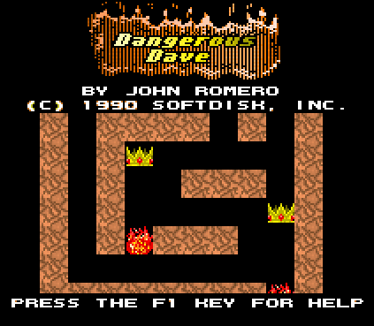
INTO THE GAMEPLAY OF DANGEROUS DAVE
About the movement controls, obstacles and enemies

Slide 10
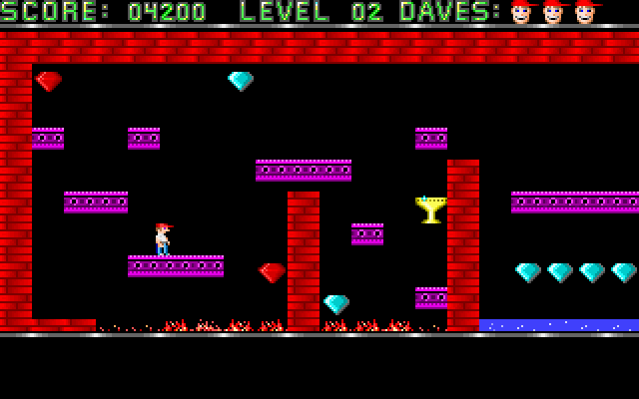
INGAME VIEW
Movement Controls:
The game offered a basic movement like any other games. The player can move left and right. Also the player has to press the up arrow key to jump high over any obstacles to reach the next level. The player access to jetpacks and guns to shoot and escape from the enemies easily.
Obstacles and Enemies:
There are many obstacles on the way to harm and destroy the gameplay. Several mini enemies, fire, acid and electric shock that easily eliminates the player character. Moving monsters that follow preset paths or actively chase the player

Slide 11
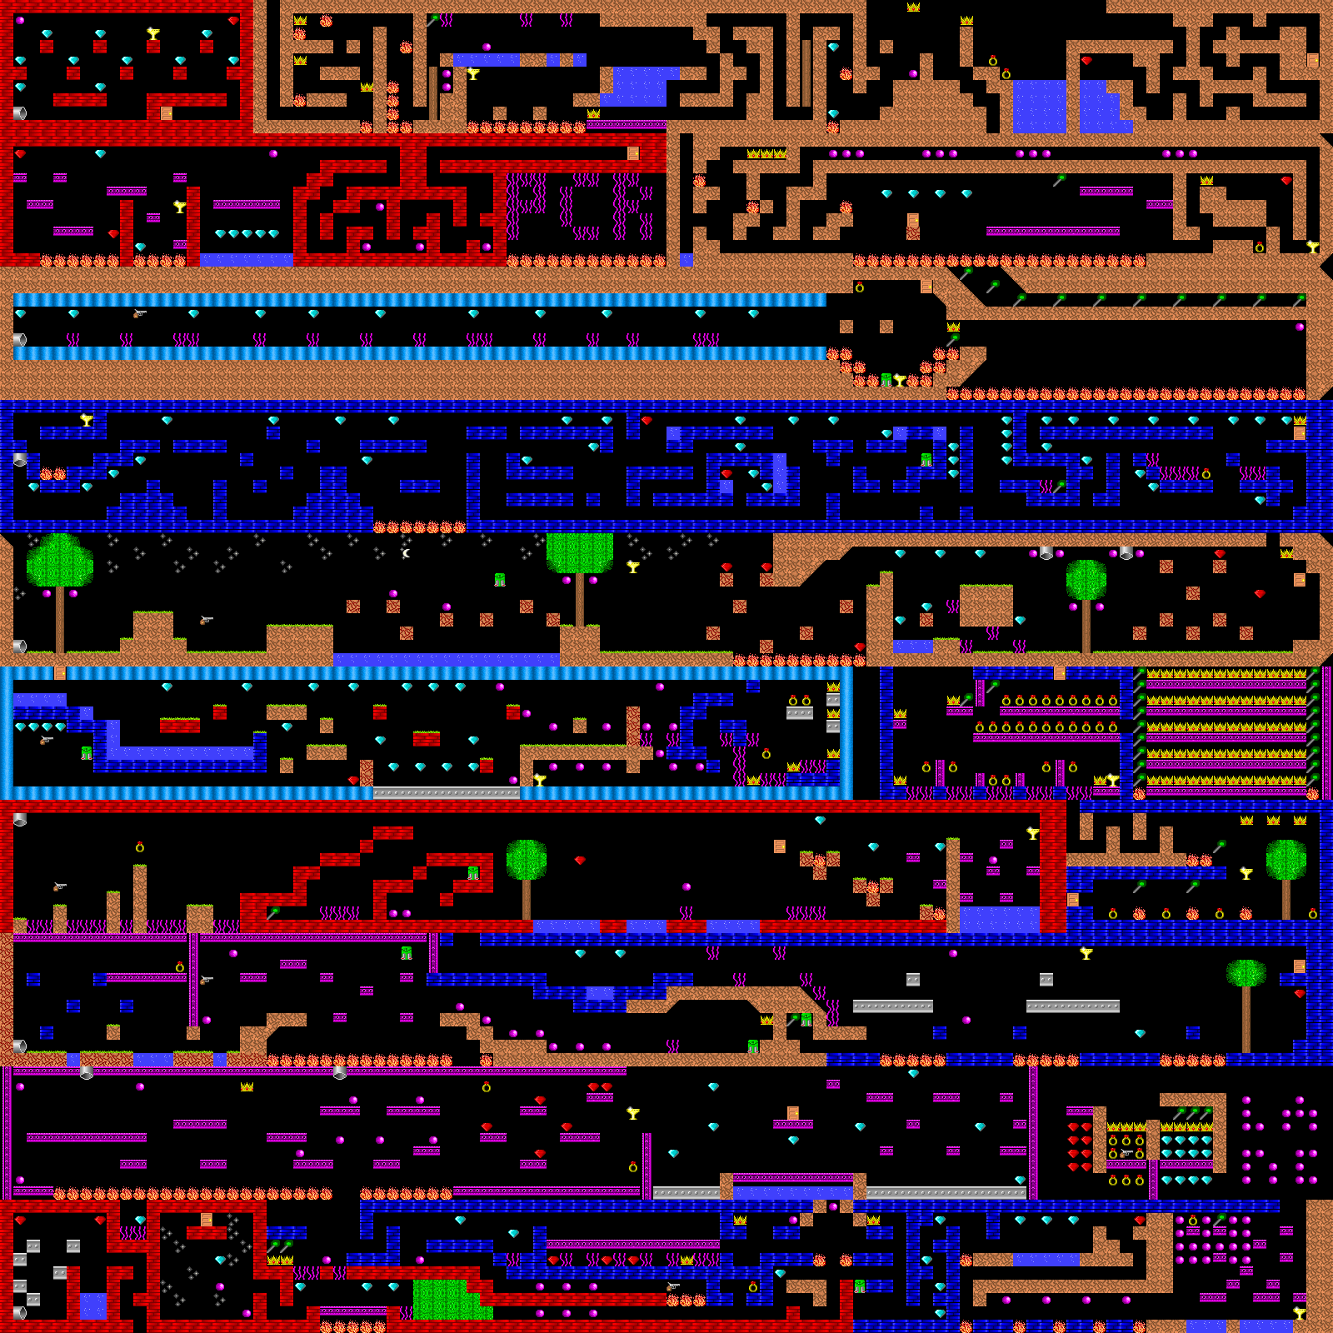
GAME LEVELS
Some levels have secret areas, while others do not.
Although there are only 10 levels, the game is designed to be more challenging than usual.
Here are the list of the enemies at different levels.
Level | Level chunk | Start | Creatures
1 | 1 | (2,8) | None
2 | 2 | (1,8) | None
3 | 3 | (2,5) | Creature 1 (spiders) at (44,4) and (59,4) - each spider is ~2x2 tiles in size
4 | 4 | (1,5) | Creature 2 (spiky ball) at (32, 2)
5 | 5 | (2,8) | 3x Creature 3 (sun) at (15,3) (33,3) (49,3)
6 | 6 | (2,8) | 4x Creature 4 (bones) at (10,8) (28,8) (45,2) (40,8)
7 | 7 | (1,2) | 4x Creature 5 (UFOs) at (5,2) (16,1) (46,2) (56,3)
8 | 8 | (2,8) | 3x Creature 6 at (53,5) (72,2) (84,1)
9 | 9 | (6,1) | 4x Creature 7 at (35, 8) (41,8) (49,8) (65,8)
10 | 10 | (2,8) | 4x Creature 8 at (48,5) (51,2) (65,3) (82,5)

Slide 12





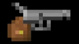



COLLECTABLES
The main collectables in the game are mentioned below
Purple Gem 50 Points
Green Staff 500Points
Blue Gem 100 Points
Cup 1000 Points
Other Collectables within the game are the jetpack and a revolver to shoot the enemies
Red Gem 150 Points
Ring 200 Points
Crown 300 Points

Slide 13



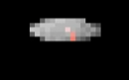




ENEMIES
After level 2, there are different types of enemies at each level of the game, each with a unique pattern that can be discovered by examining them.
Level 6 Movement :Linear Firing: 1 shot after every rotation Kill Reward: 600
Level 3 Movement :Circular Firing: 1 shot after every rotation Kill Reward: 300
Level 7 Movement :Circular Firing: 1 shot after every rotation Kill Reward: 700
Level 4 Movement :Circular Firing: 3 shots during rotation Kill Reward: 400
Level 10 Movement :Linear Firing: 1 shot after one complete linear movement. Kill Reward: 10000
Level 8 Movement :Circular Firing: 2 shot after every rotation Kill Reward: 800
Level 5 Movement: Circular Firing: 2 shots during rotation Kill Reward: 500
Level 9 Movement :Linear Firing: 1 shot after every 2 rotation Kill Reward: 900

Slide 14



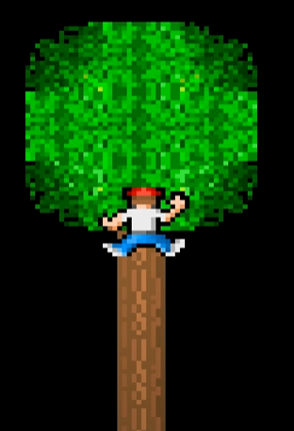



WORLD BUILDING
Some of the elements used in the game to make interactive are the entry and exit of the character. Dave enters through a pipe and exit through a door.
Players can interact with the trees and stars
Entry to the next level
Get out from the current level
Fuel Bar of the jetpack
Some of the obstacles in the game that causes damage

Slide 15
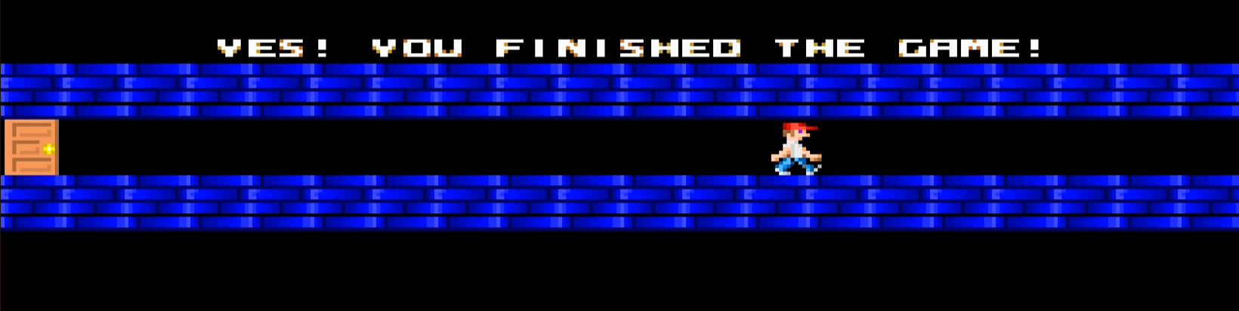
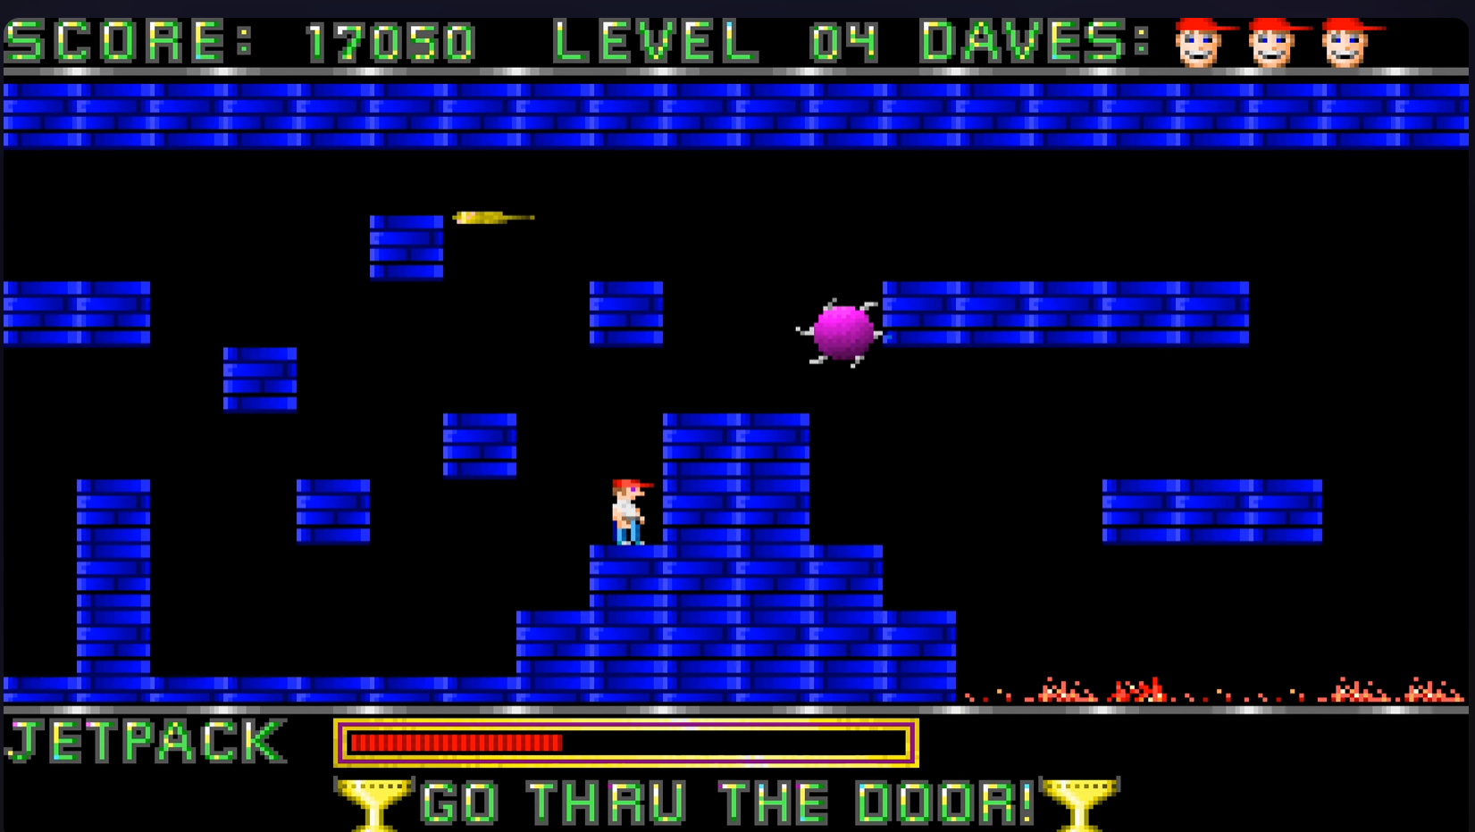
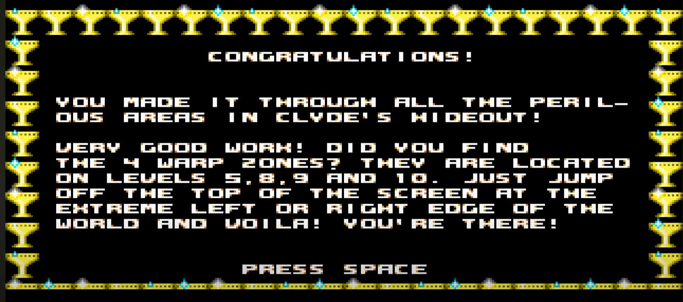
UI DESIGNING
The loading screen to the next level in the game Is just the walking animation of the game character, which is of less frame rate of animation informing us how many round are more to complete in the game.
The main game interface shows the score, current level and number of health on the top. Below has the jetpack and its fuel count. If the player picks the gun it also shows its availability in the game with a gun icon. The ending of the game congratulates the player for completing the game and a hint about the warp zone in different levels.

Slide 16
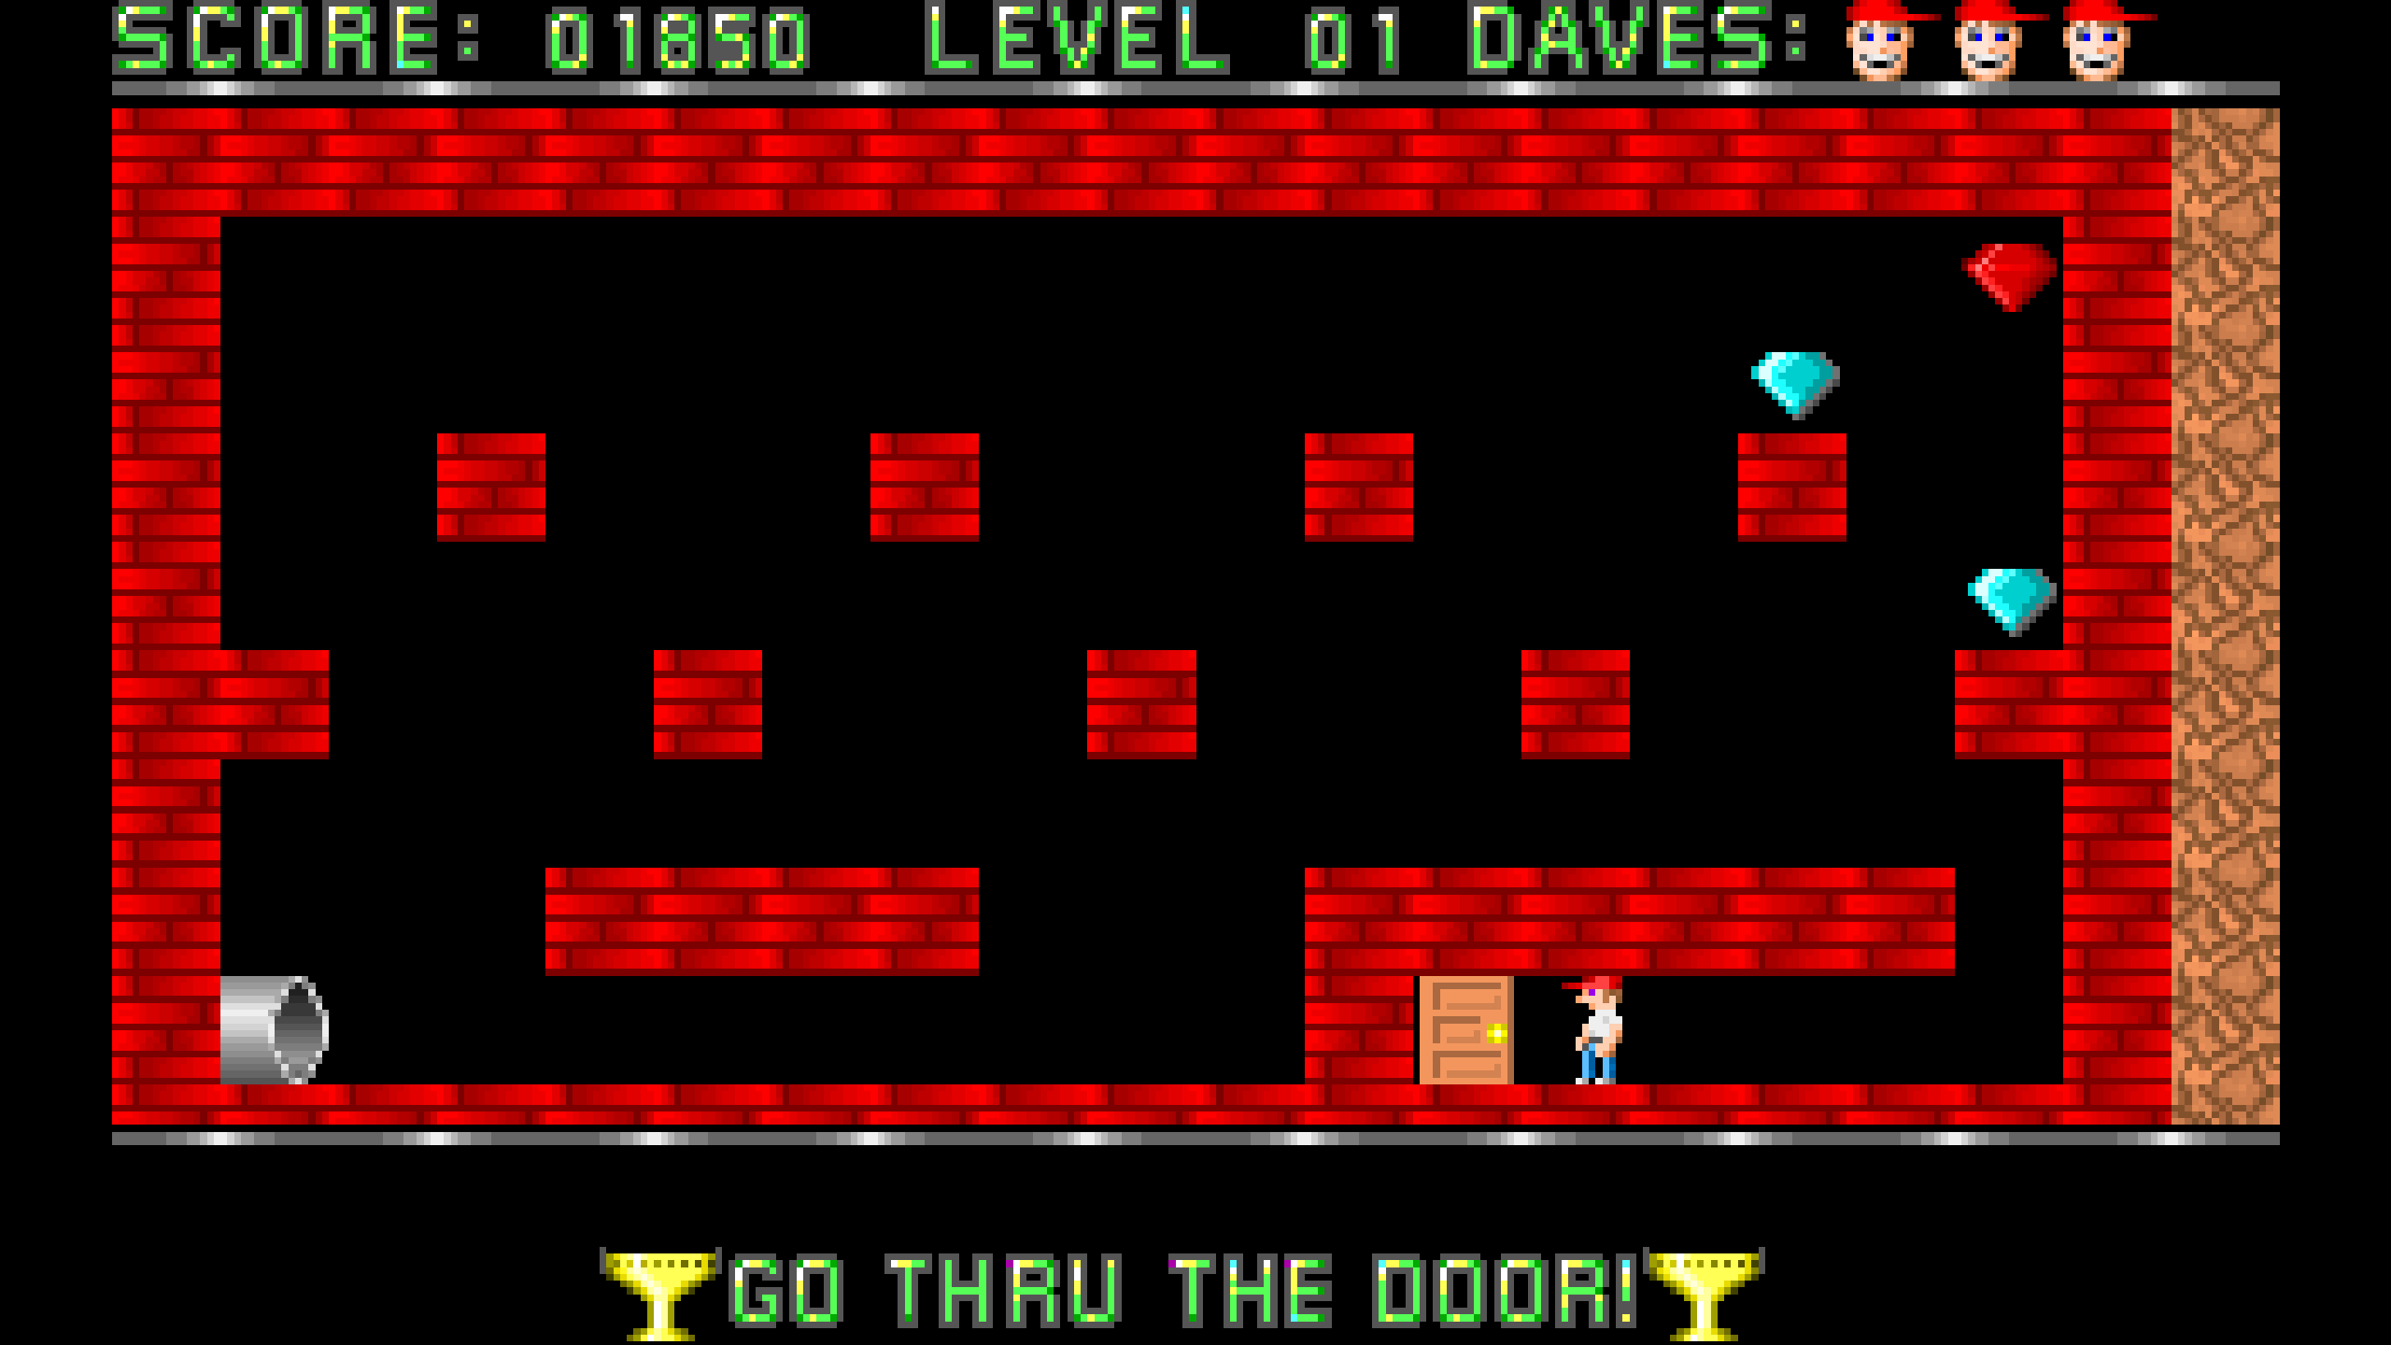
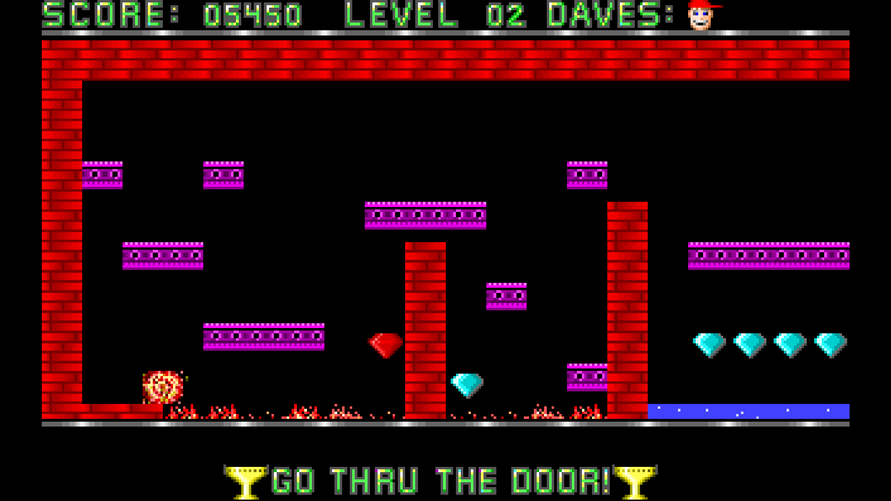
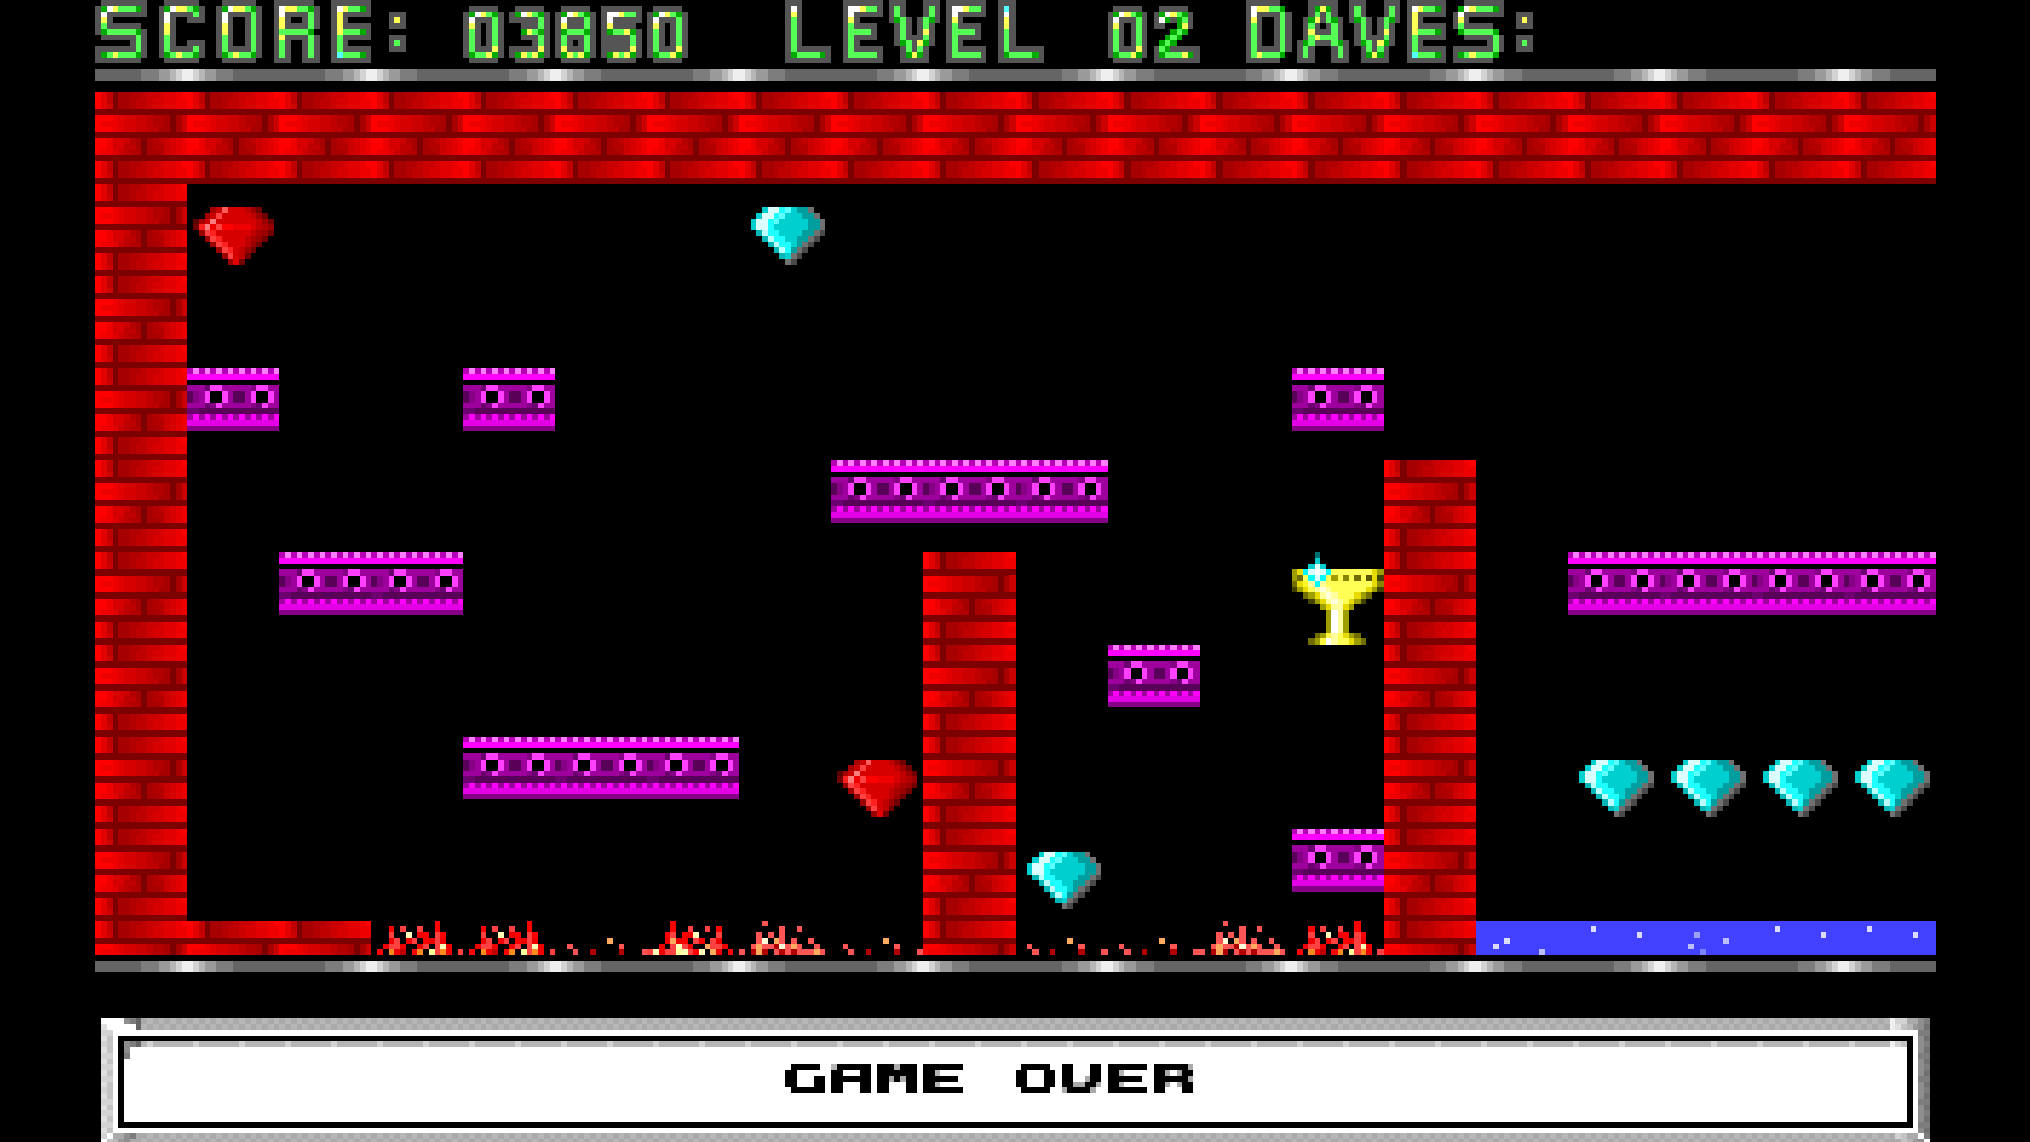
Points to remember
You can easily complete the each round just by collecting the golden cup.
Each movements and collecting things produces different sounds throughout the.
The player gets easily eliminated by the obstacles in the game easily.
If you collect the golden cup the game directly ask you to go through the door without collecting anymore gems.
Player cannot go back through the pipe again as it causes a error sound when the player approaches the pipe.
In the 3rd level if the player try to pass the spider without shooting it, the spider chases you to death.
If the player looses his entire health, the game ends and ask the player to start the game from the beginning.
From the 9th level of the game some of the pink ground plates are hollow which surprises the player and gets killed by falling into any of the obstacles.
Whenever the player completes a level and reaches another lever he receives 2000 points as rewards

Slide 17
REBUILDING THE GAME
NEW TITLE FONT
GAME COPY
MAIN CHARACTER
SIDE CHARACTERS
ANTAGONIST
Region based obstacles
Character equipment
COLLECTABLES
story UI DESIGNING
Sword powers
BACKGROUNG FINAL OUT

Slide 18


NEW TITLE FONT
1998
2024
The title style of the Dangerous Dave game series reflects the retro aesthetics of early 90s platformer games
The new title of the game adapt the color from the old title. The pixel effect is still maintained through out the game to keep up the aesthetic feel of the game.

Slide 19
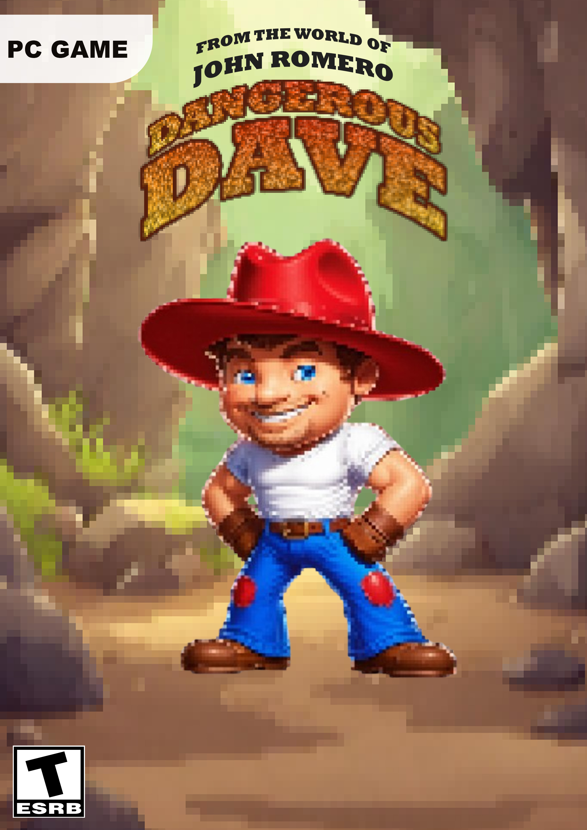
GAME COPY
1998
2024
1998

Slide 20

CHARACTER
DAVE 1998
DAVE 2024
Block Size – 25
The character is more detailed with a change in the hat,bet and shoes.The character also uses a gloves
Health bar is 100%
Block Size – 2
The character is less detailed
Health is 3

Slide 21




SIDE CHARACTERS
Theses are four main side characters in different areas, asking help from the main character of the game where the offer potions, weapons or any other items to upgrade the health of the character.
Deer Man the protector of the wild woods
Leefy the tree character
Feebi a young witch
Denji the village man

Slide 22
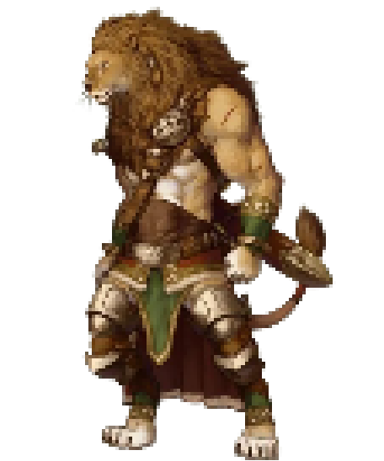
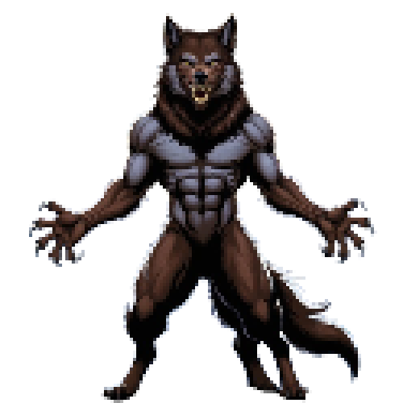

ANTAGONIST
There are mainly three Antagonist through out the game challenging Dave
Venomous Viper
Viper Spit Attack – 20% health loss
Werewolf
Attack – 45% health loss
Mighty Lion
Attack – 55% health loss

Slide 23



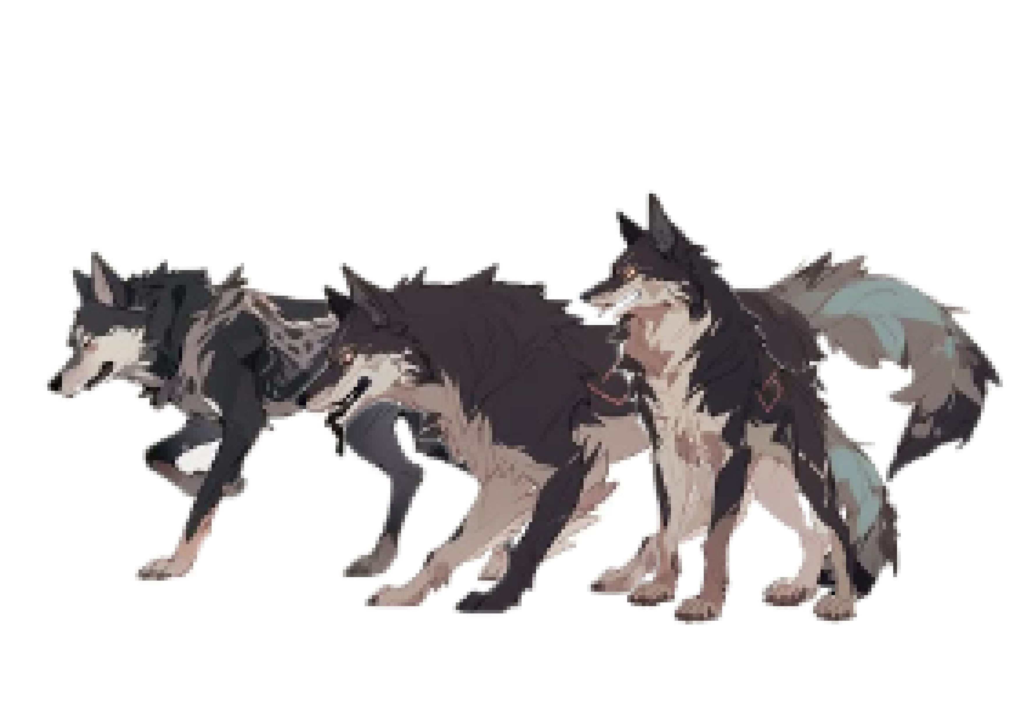


REGION BASED OBSTACLES
These are the sub characters of the main antagonist where the layer can face them in between the journey of the character or even before approaching the main villains.
Wolf
Damage 30%
Poisonous Snake
Damage 5%
Weed
Damage 15%
Poisonous Snake
Damage 10%
Giant Weed
Damage 25%
Wolf
Damage 45%

Slide 24






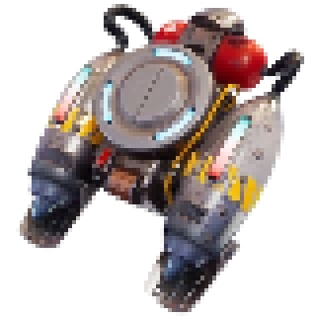
Character Equipment
These are the main 3 potions that the character can create using the gems that spawns on the way and in some regions.
Hand Revolver
Machete
Speed Potion
Full Power (Health and Speed)
Dynamite
Jetpack
Hand Revolver with a limited bullets and a pair of Machete are used to kill the enemies. Dynamite are also used for a quick escape as it creates damage and a quick jump. Also Jetpack is available throughout the journey.
Health Potion

Slide 25
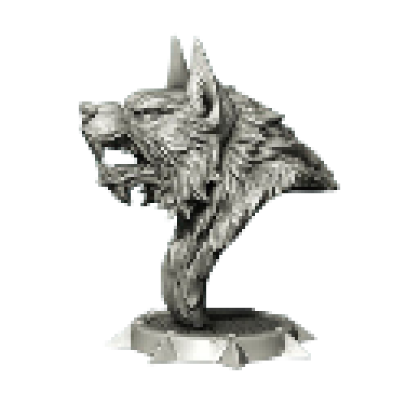
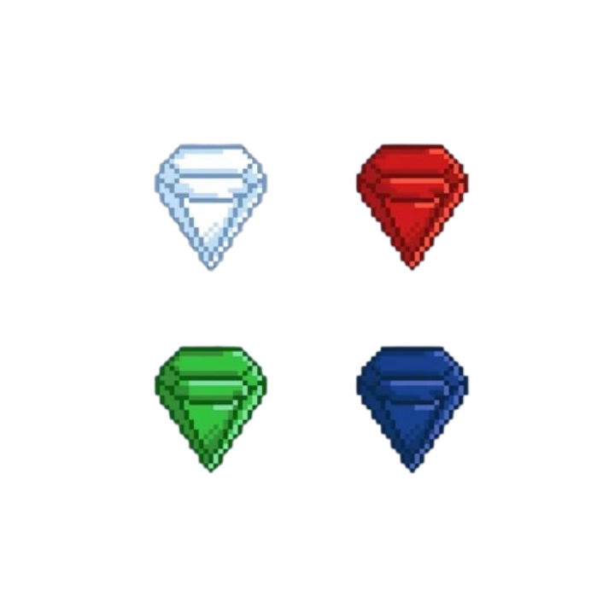

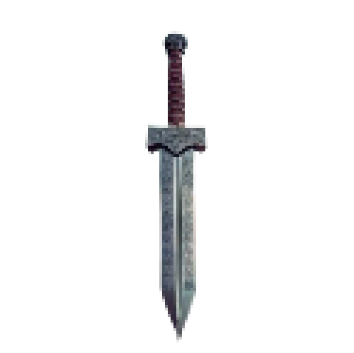
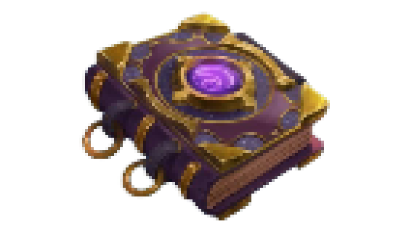
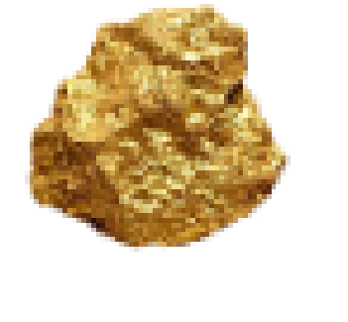
COLLECTABLES
Some of the collectable are similar from the first game of Dangerous Dave. Whereas others are added and be collected after defeating the main 3 Antagonist.
Werewolf stone statue
4 different gems with different points
Viper Stone
Gold
Mighty sword of Mighty Lion
Enchanted Book

Slide 26
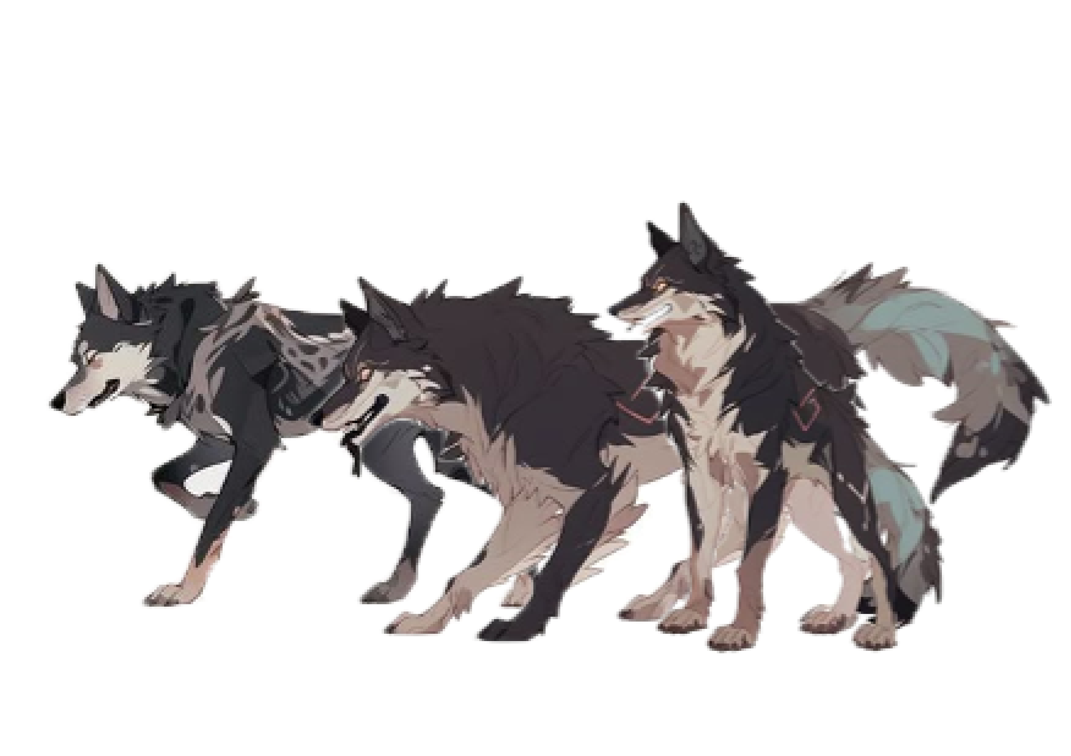
STORY

Slide 27



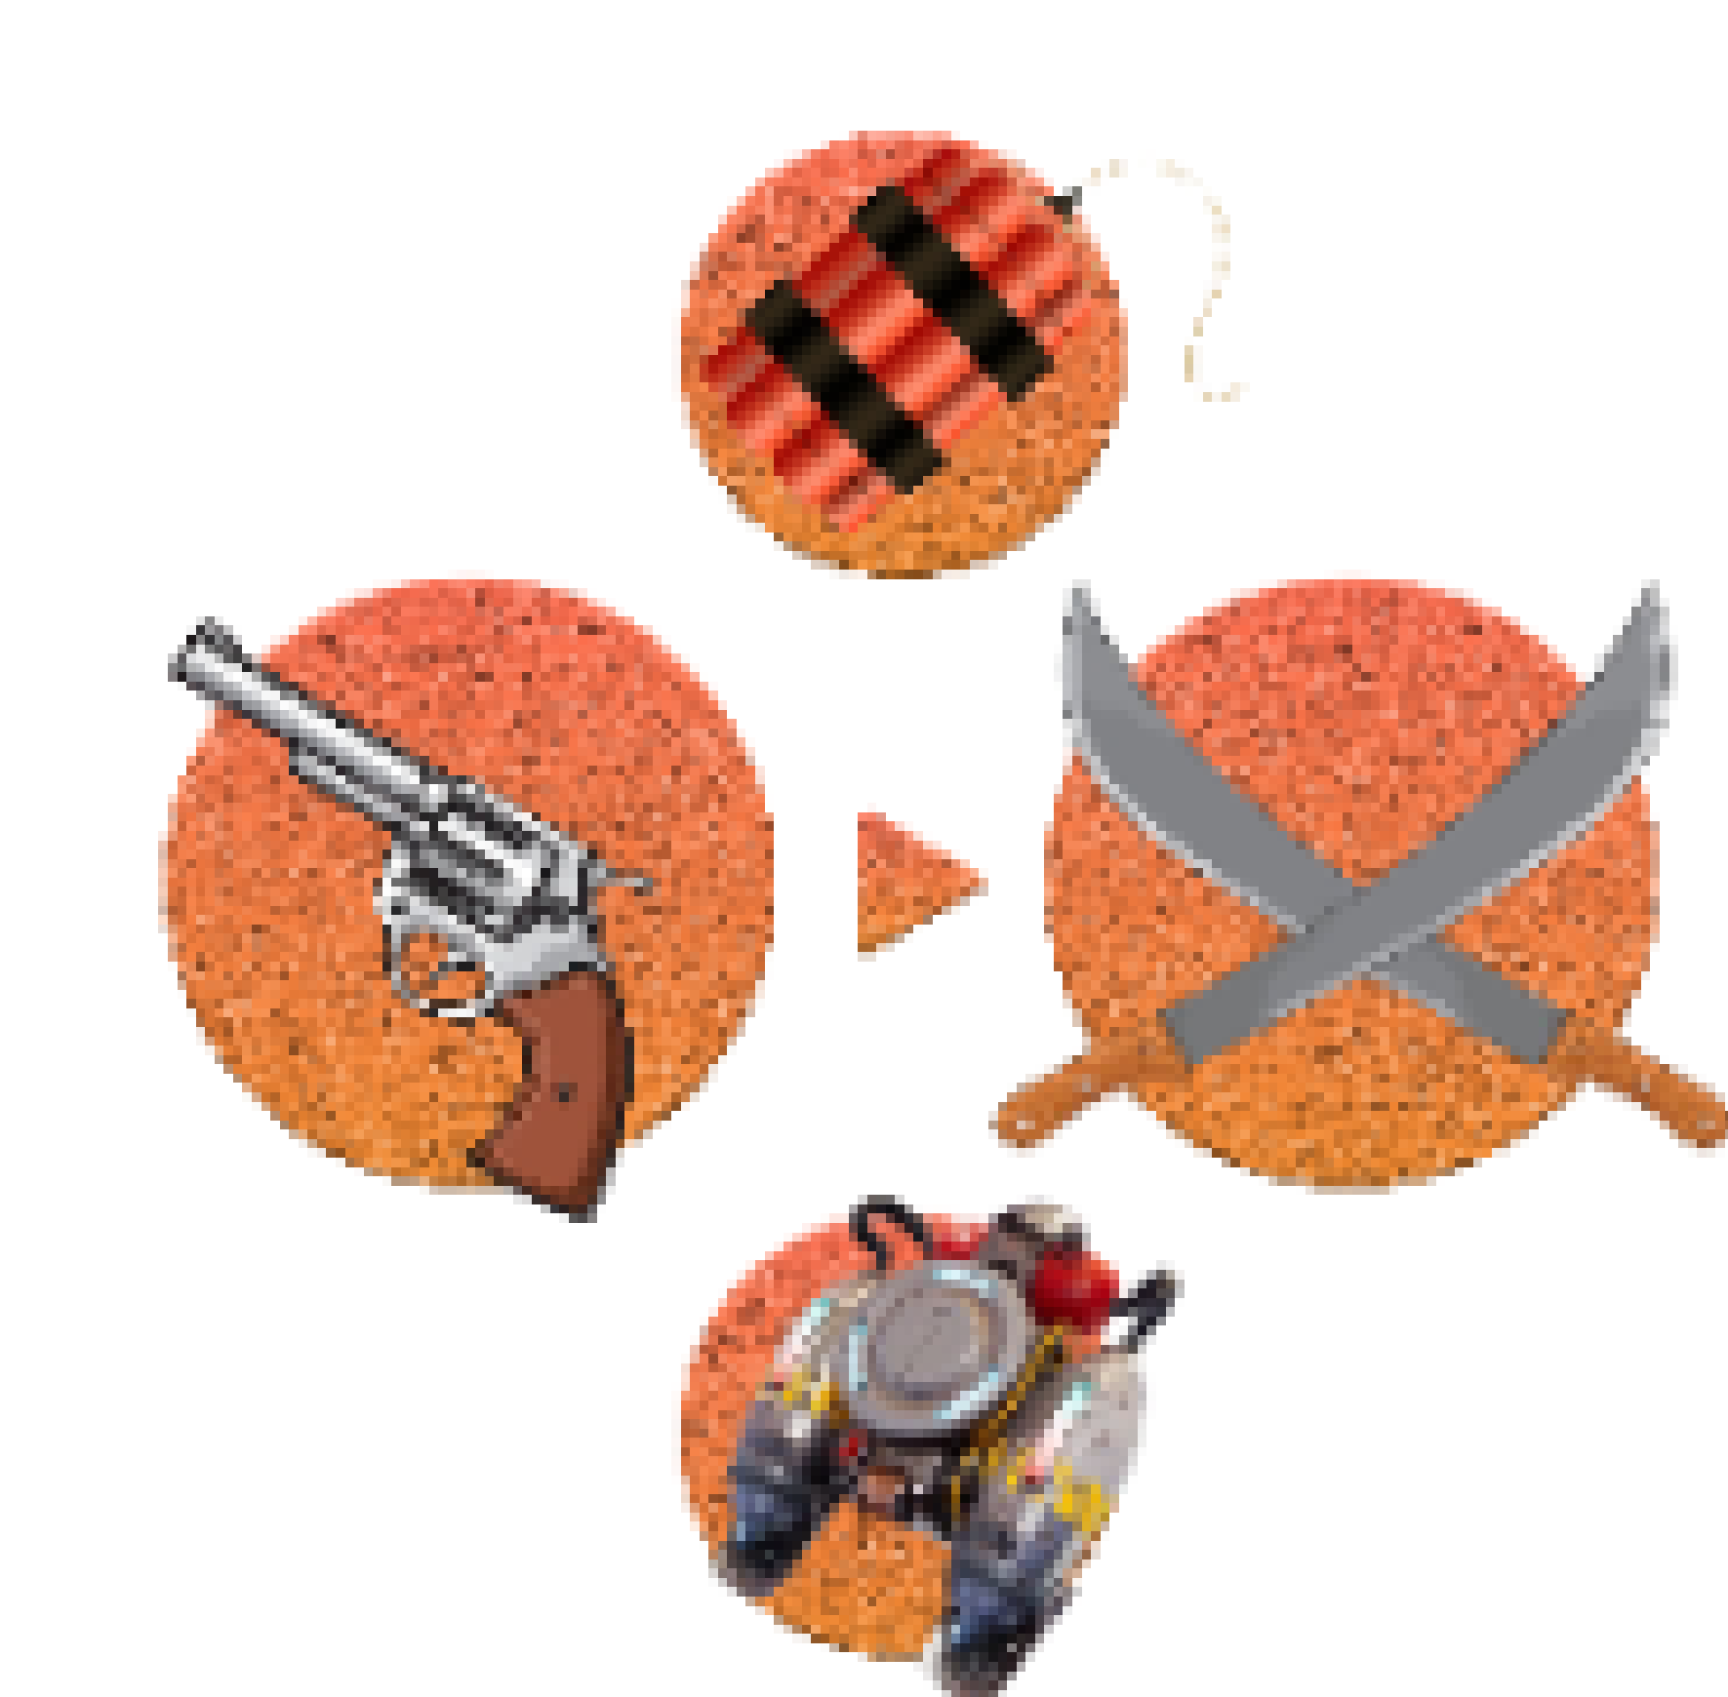
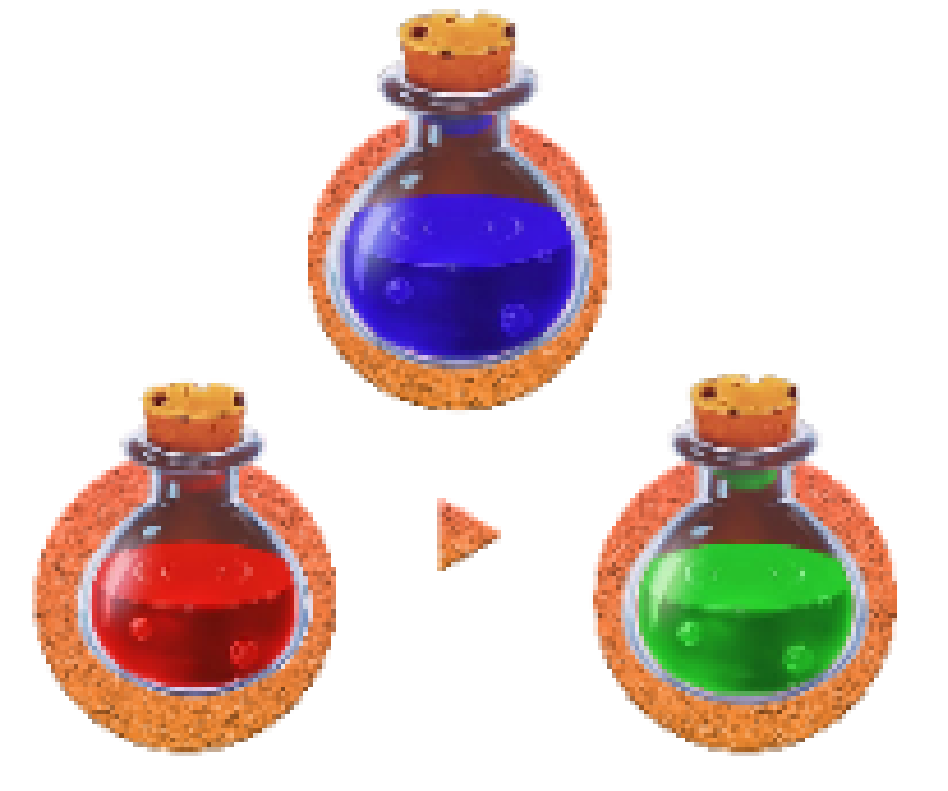
UI DESIGNING
The UI color pattern focus on the color pattern of the newly developed title. Only the special power bar has different colors according to the power the character gain.
Bullet count from the gun
The DD refer to the name of the game as it rotates while saving the game and reaching check points
The DD refer to the name of the game as it rotates while saving the game and reaching check points
Choosing Weapons
Choosing Potions

Slide 28




sword POWERs
The Mighty Sword of the Mighty Lion used in the game has special powers. In the final level Dave has to fight The Mighty Lion, were the sword can use for wind,fire and lightning powers against the game character.

Slide 29
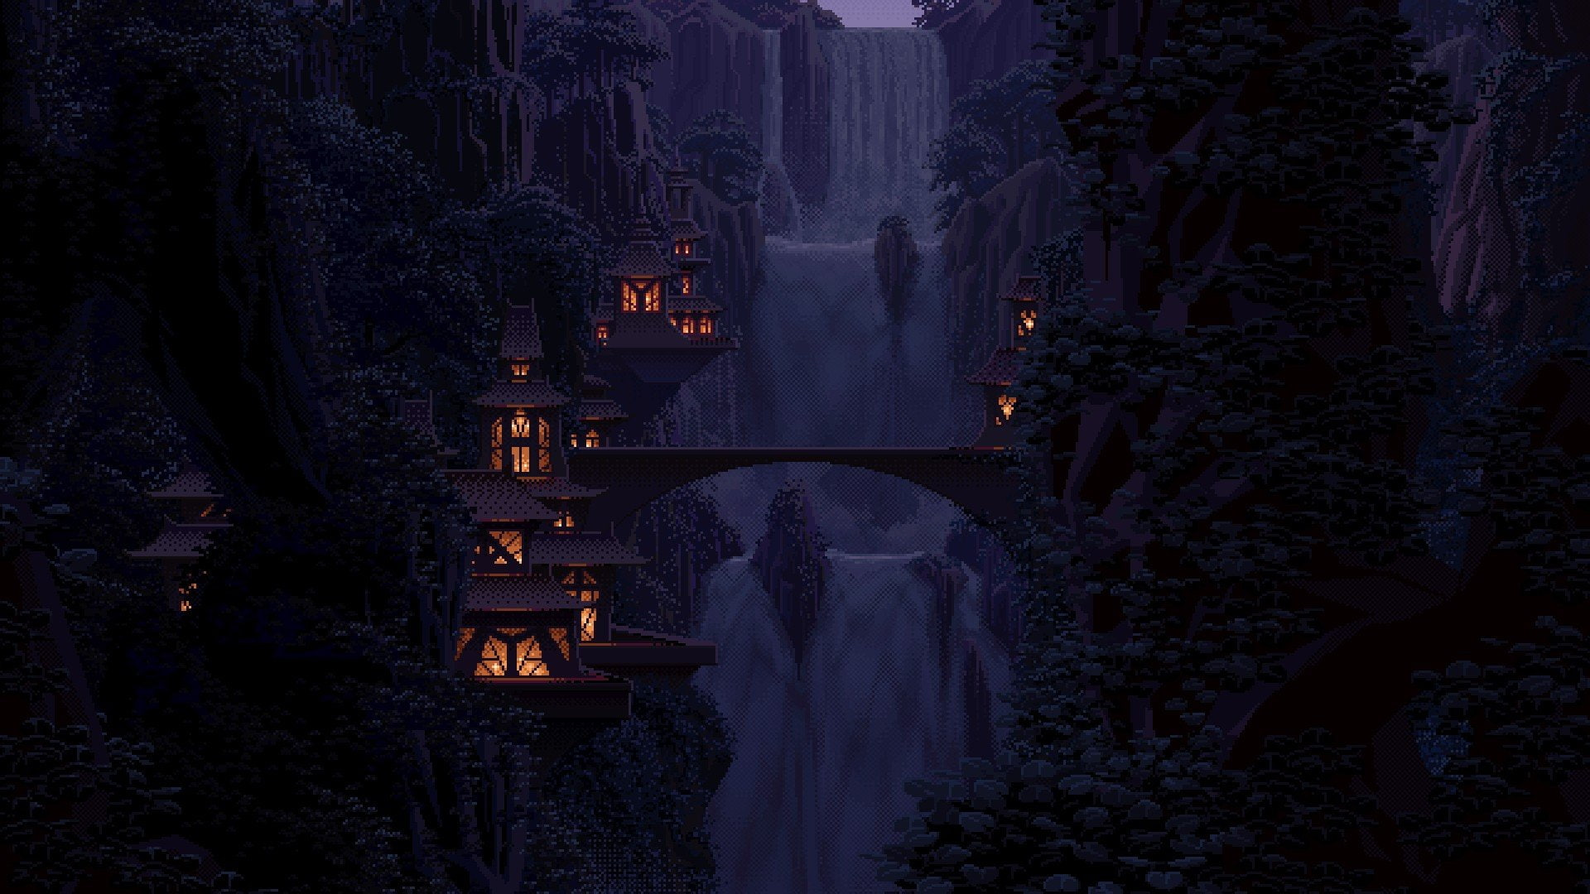
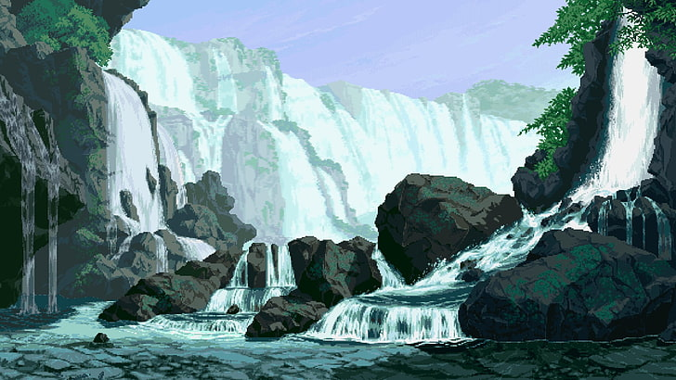
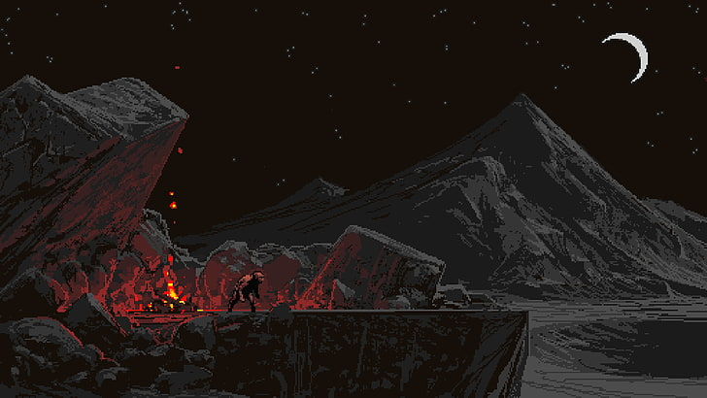
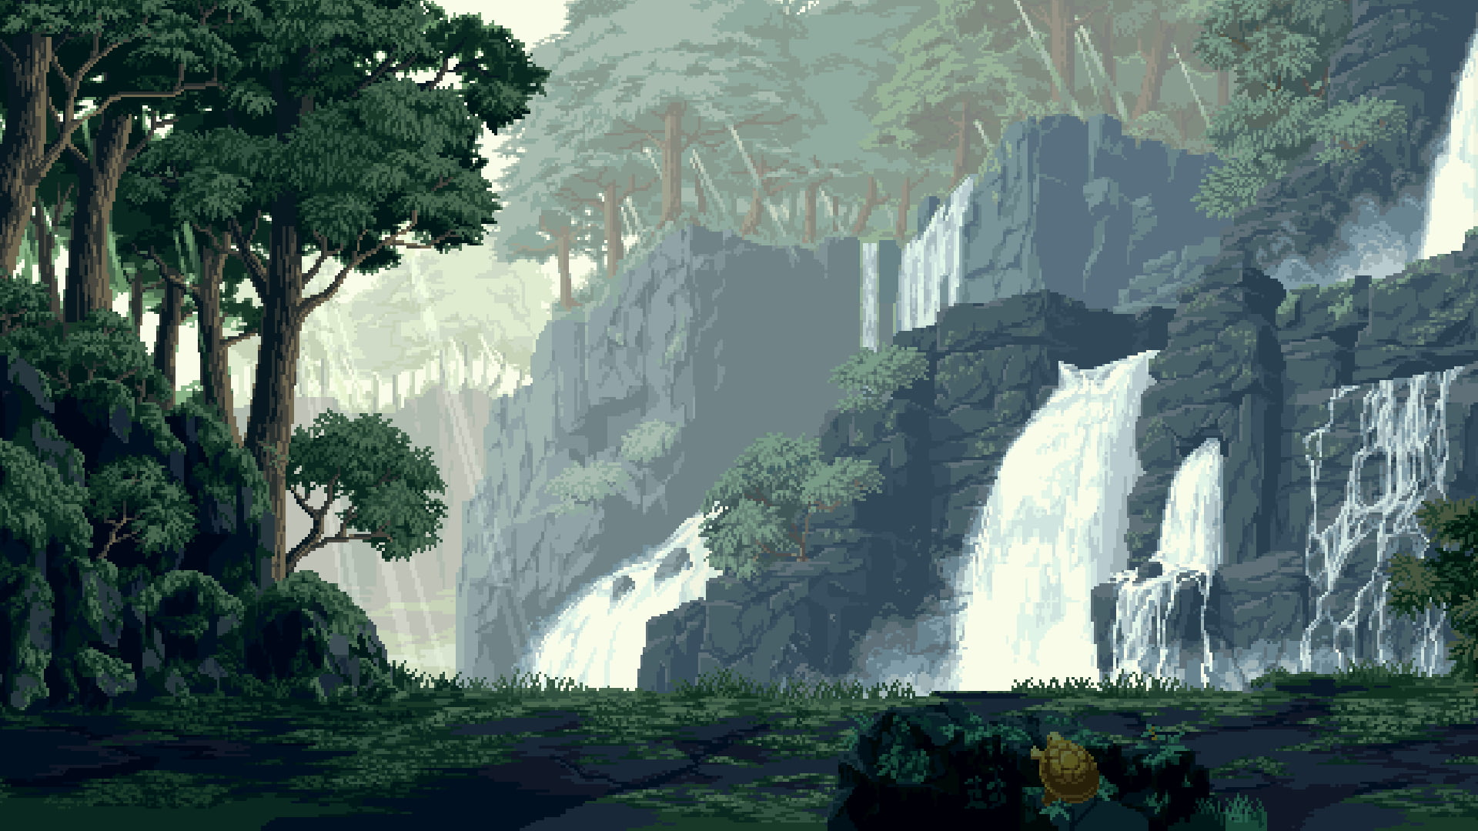
BACKGROUND
These are some of the different regions the character has to travel

Slide 30
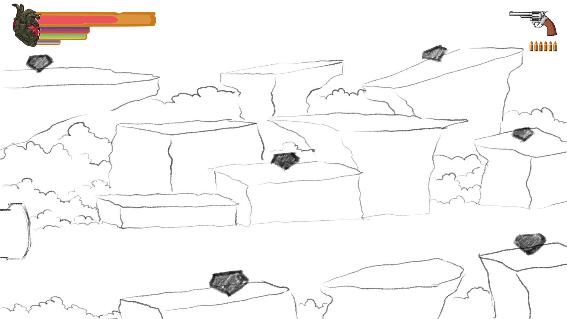
FINAL OUTPUT
This is the final round where the character enter to fight the last boss The Mighty Light. Here the collectables will be randomly spawned for the player to collect and refill the powers for potion

Slide 31
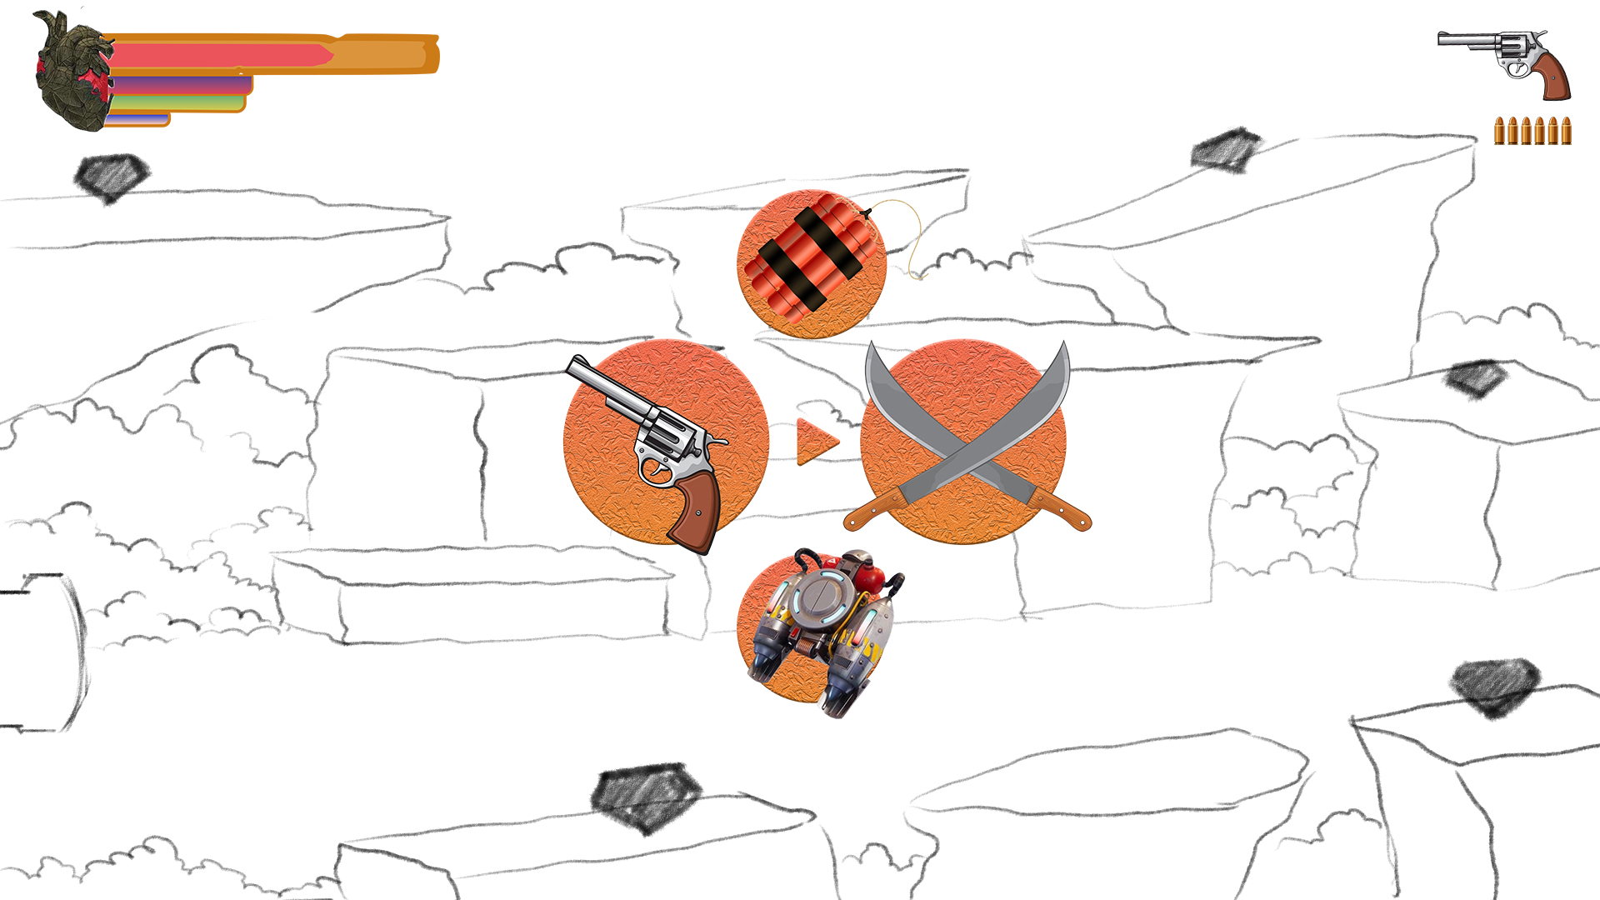
FINAL OUTPUT
This how the screen turns when the player goes for the equipments

Slide 32
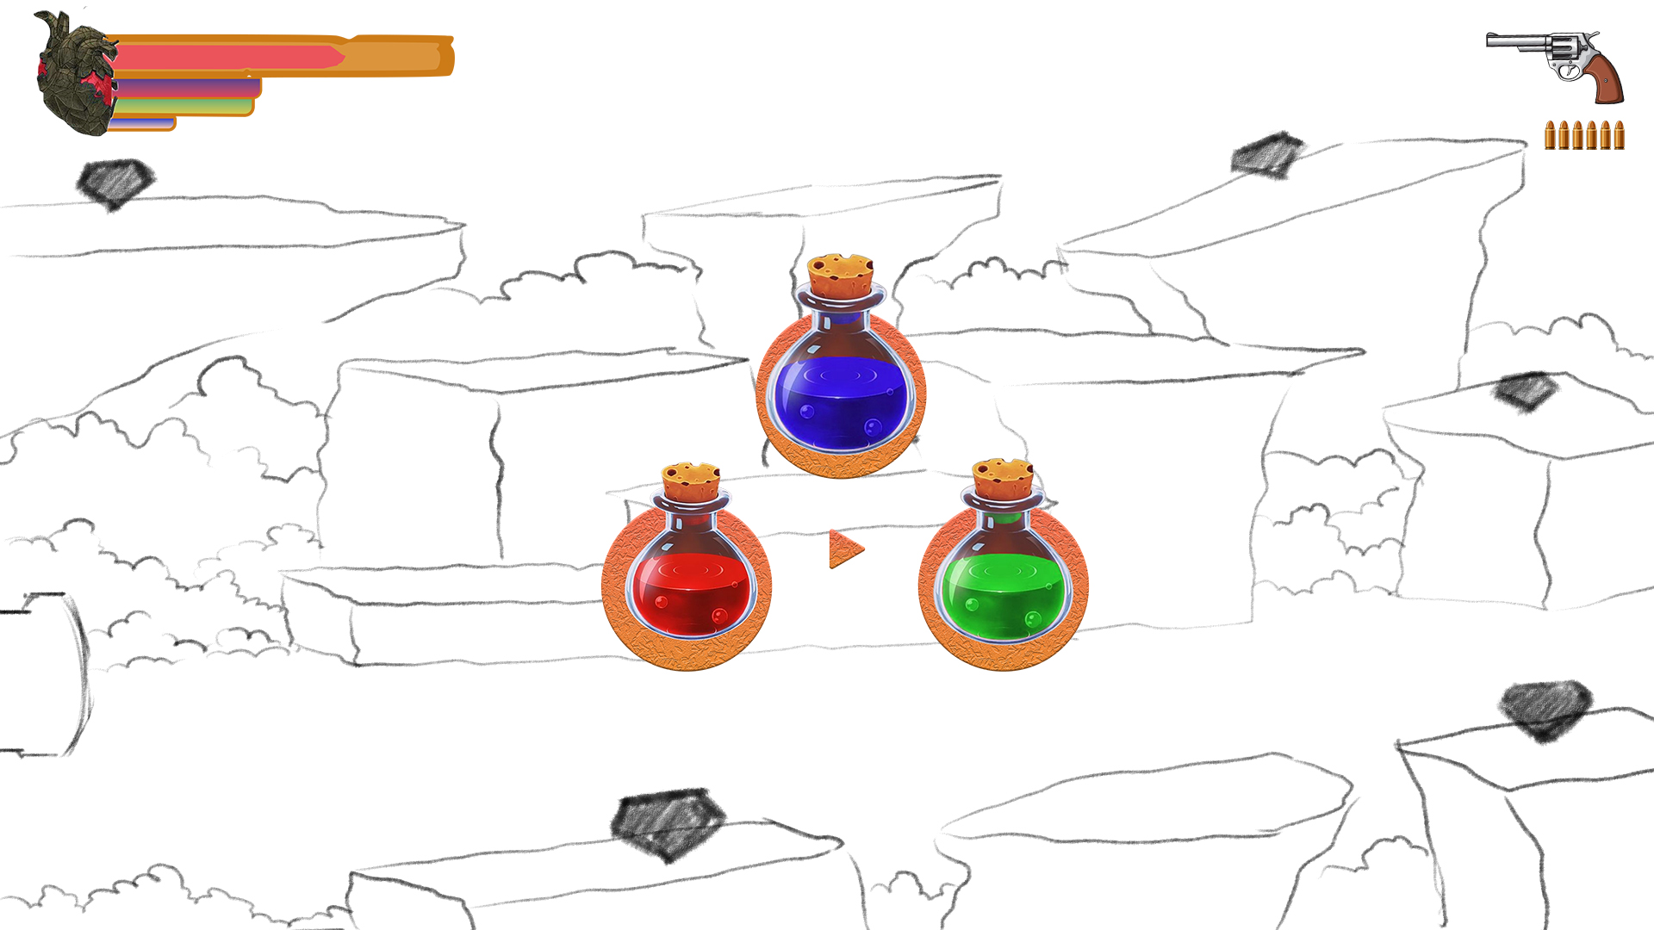
FINAL OUTPUT
This how the screen turns when the player goes for the potions

Slide 33
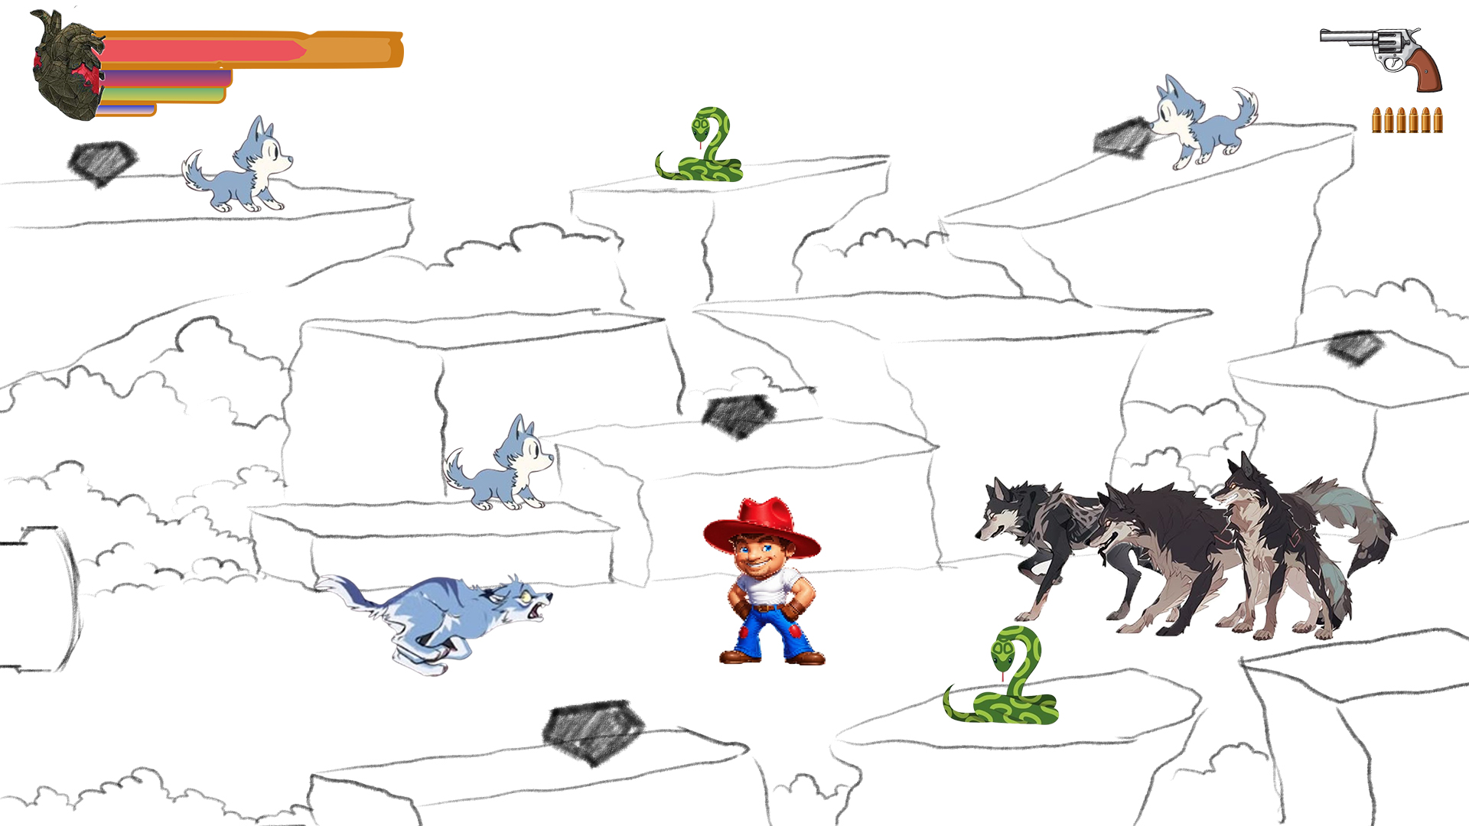
FINAL OUTPUT
This is the first stage of the boss fight where the Lion invites everyone to fight our character

Slide 34
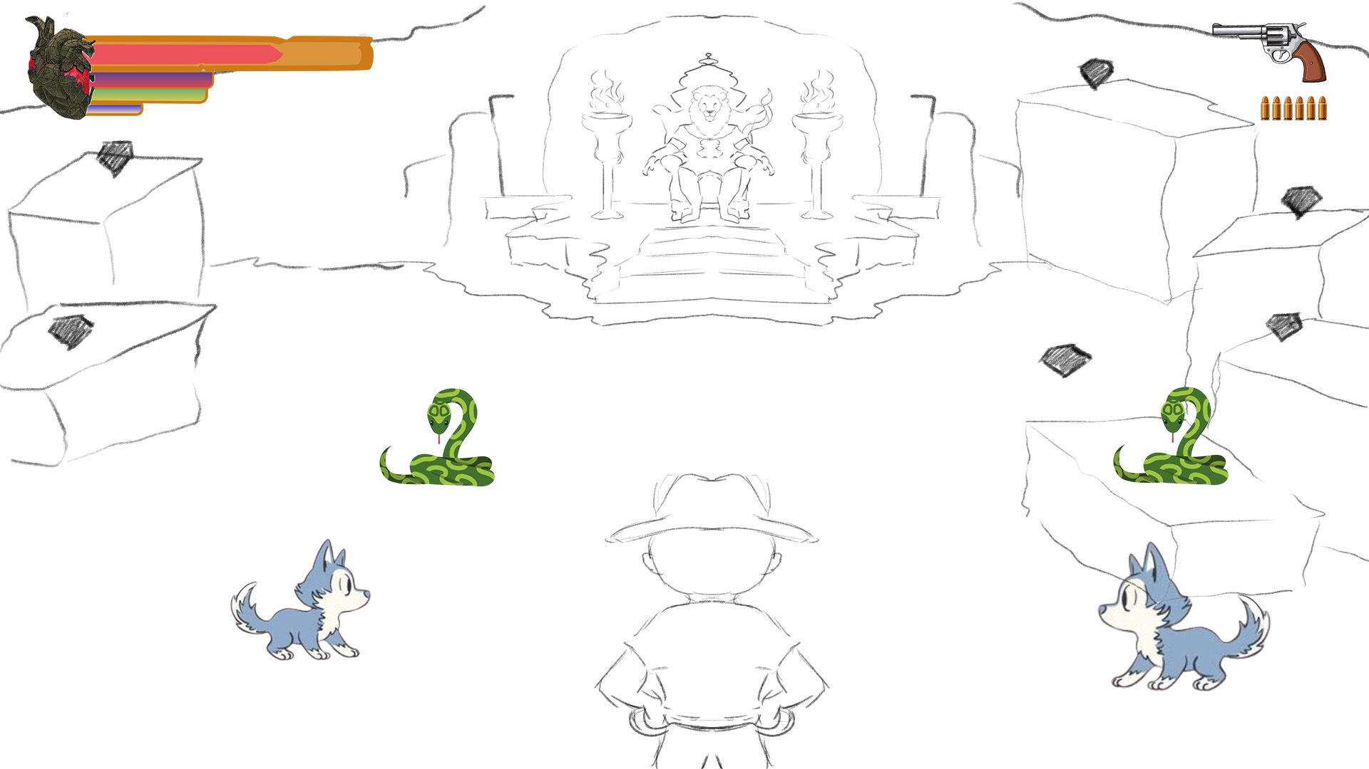
FINAL OUTPUT
Boss Faceoff

Slide 35
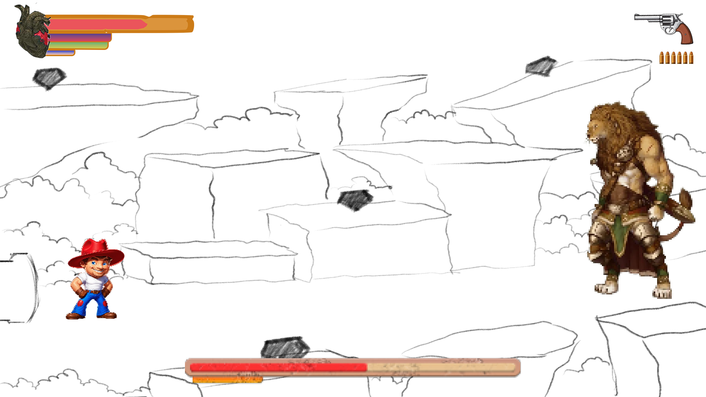
FINAL OUTPUT
Boss Fight

Slide 36
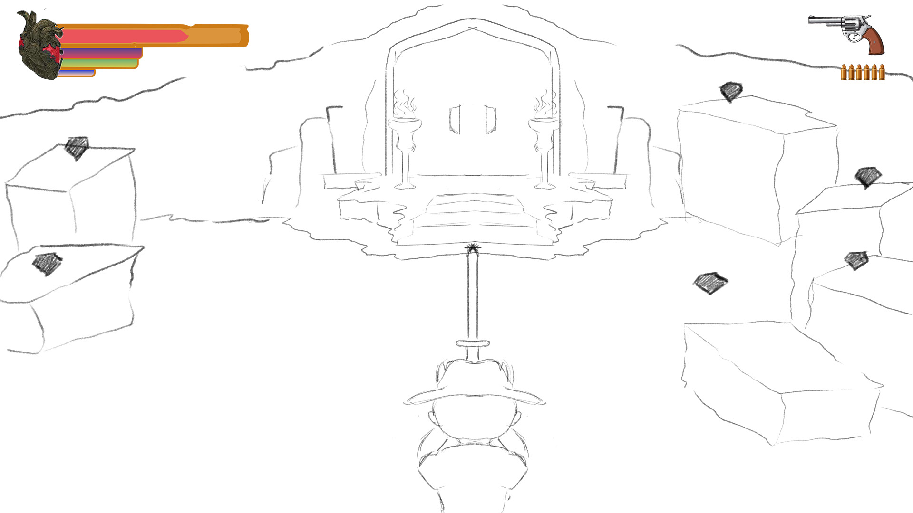

FINAL OUTPUT
After the boss fight Dave gets a Mighty Sword. The throne of the Mighty Lion turn to dust and a giant door appears in front of Dave. Also a piece of gold will be rewarded.

Slide 37
THANKYOU

